Slide 1
POLS 207 State & Local Government*
Chapter 9B-2
Opposing Gerrymandering
Dr. Roblyer, Ph.D.
*These slides are based on originals provided by Dr. Harvey Tucker

Slide 2
Learning Objectives
Describe the strategies that were used by activists to successfully oppose discriminatory gerrymandering for many years.
Explain the SCOTUS decision in LULAC v. Perry and its consequences.
Discuss why gerrymandering is not invincible.
Describe why gerrymandering is a major concern in Texas and other states.
Explain how gerrymandering played a role in Republicans gaining and keeping control of the Texas Legislature.
Describe how independent commissions are being used to push back against gerrymandering, as well as why Arizona and Texas are cautionary cases.
Characterize the use of alternative redistricting approaches in the US states.

Slide 3
Learning Objectives
Discuss how proportional voting (Chpt 7!) is laid out as a better means of resolving the problem of gerrymandering than are independent commissions.
Compare and contrast congruency and communication-based models of representation.
Characterize the similarities between state legislators and their constituents.

Slide 4
How were gerrymandered maps successfully opposed for many years?
Proving violations of any of four rules covered earlier
Equality of population
Continguity of district
Representation of Protected Groups
Shape of district
Use of either of two legal strategies
Arguing that redistricting should only be permitted once each decade (following reallocation driven by census)
Arguing that the state officials redrawing the lines were showing “excessive partisanship”
Courts then expected state officials to prove this was not true
Reliance on the federal government to stop most gerrymandering in all VRA-covered states via pre-clearance
Gerrymandering was still common, but was about to become even more so!

Slide 5
LULAC v. Perry: Protections against gerrymandering eroded
(League of
Latin American
Citizens)
2006 Supreme Court decision concerning Texas congressional redistricting by Republican Legislature
Undercut both legal arguments used routinely to overturn gerrymandering
Frequency: Court said perpetual re-districting is legal
Do it as often as desired: If at first you don’t succeed: redistrict, redistrict again!
Excessive Partisanship: Court made it much harder to claim this “unsportsmanlike conduct” during redistricting
Court permitted Republicans to use maximum partisan advantage as their only goal for redistricting
Now, party with complaint has to define & measure any excessive partisanship they claim has motivated the resulting new map
Result: Redistricting map declared unacceptable in 1996 was approved in 2006
….then Shelby County v. Holder removed the extra checks against frequently offending states

Slide 6
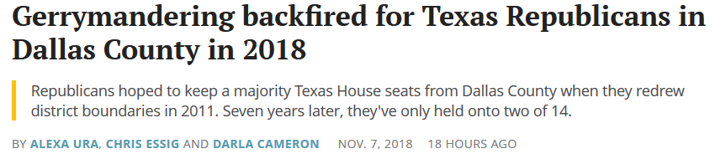
Gerrymandering is powerful, but not invincible!
https://www.texastribune.org/2018/11/07/dallas-county-republican-gerrymander-backfires-2018/?utm_campaign=trib-social&utm_content=1541686163&utm_medium=social&utm_source=twitter
Why?
Surge in voter turnout
Demographic changes in districts that are shrinking white influence

Slide 7
Gerrymandering Matters…
Every census since 1960 reflects growing partisanship in how districts are drawn
Ballotpedia predicted in 2016 that only 23 of 435 congressional districts would be a fair competition between parties
Now gerrymandering can be done better than ever before with computers, databases
Party who will win a future election is largely controlled by redistricting now
Marks of gerrymandering in Texas:
All 31 state senate districts were unopposed in 2016 elections
144 of 150 state house districts were unopposed in 2016
Executive state-level elections remain somewhat competitive, but most legislative contests are not
…Why is this?
https://ballotpedia.org/U.S._House_battlegrounds,_2016

Slide 8
What Most Texans Believe:
“Republicans became the majority party in the house by defeating democrats in general elections”
Competition is what politics is all about… right?

Slide 9
The Real Reason? Rigging the Game!
Remember: …legislative general elections don’t matter when gerrymandering is prevalent!
Texas Republicans became majority party immediately after districts were gerrymandered in 2001
Legislative Redistricting Board: 4 Republicans, 1 Dem (at that time)
Drafted all changes to district lines for legislature
What about the VRA pre-clearance requirement?
Republican U.S. Attorney General did not object to newly drawn district lines
…even though redistricting plan targeted districts of Democratic leaders and Anglo democrats

Slide 10
Texas State Legislature: Partisan Division Since 2001 Redistricting
SENATE | REP | DEM
2003 | 19 | 12
2005 | 19 | 12
2007 | 20 | 11
2009 | 19 | 12
2011 | 19 | 12
2013 | 19 | 12
2015 / 17 / 19 20 / 20 / 19 11 / 11 / 12
House | REP | DEM
2003 | 88 | 62
2005 | 86 | 64
2007 | 80 | 69
2009 | 76 | 74
2011 | 101 | 49
2013 | 95 | 55
2015 / 17 / 19 98 / 95 / 83 52 / 55 / 67

Slide 11
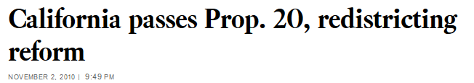
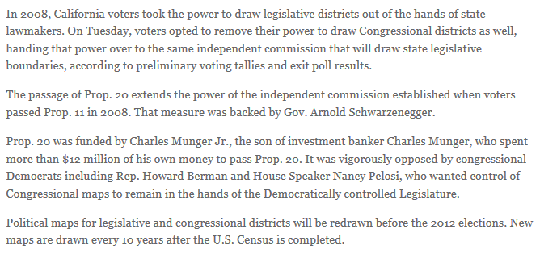
A State Reforms Redistricting
California has successfully done it twice
CNN report - https://youtu.be/UVV2N8ctrEc http://www.youtube.com/watch?v=Ucm9ehYe4NM
Full documentary (optional) - https://youtu.be/jaeAUel3cns
Opposition was very strong (see below)
Perhaps only possible because state had voter initiative and backer was very wealthy
View this on your own…
http://latimesblogs.latimes.com/california-politics/2010/11/california-passes-prop-20-redistricting-reform.html
Iowa &
Arizona
have done
this, too, sorta…

Slide 12
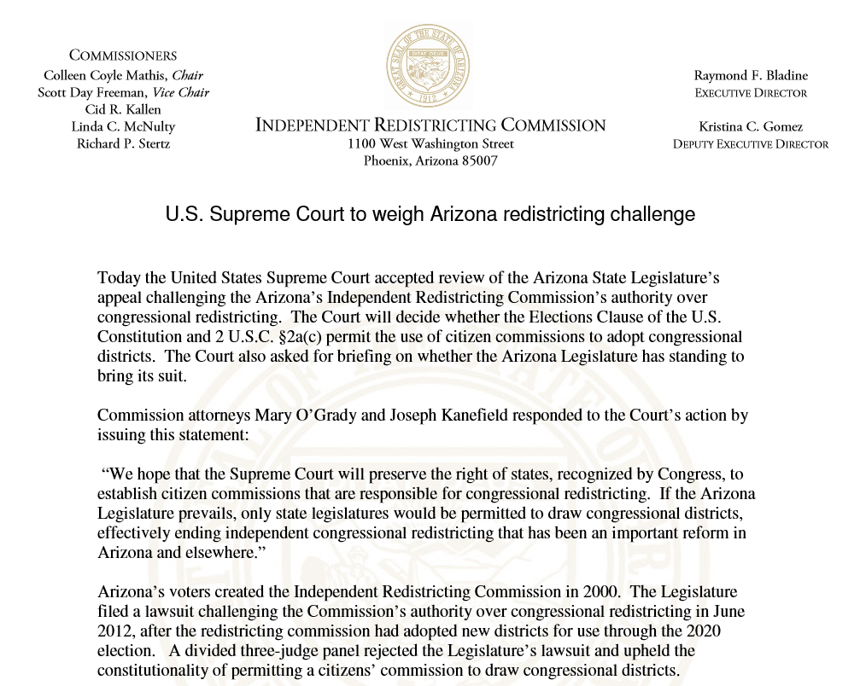
Is Redistricting Reform a Panacea?
Difficult to enact
Texas Senate has approved bills in 2005, 2007 & 2011 to establish a citizens’ commission, but Texas House has never agreed
“Independent” commissions are still susceptible to partisan influences—may become “independent” in name only
Who appoints the commissioners?
Are politicians born or made? Who is not susceptible to the power and privilege?
Where independent re-districting has been enacted, it hasn’t always delivered desired changes
AZ voters established independent commission in 2000 via voter initiative
First district maps were not approved by commission until 2012
AZ legislature sued commission to stop use of maps
In 2016, SCOTUS agreed that commission was legit and AZ should use maps
http://www.azredistricting.org/docs/PR-20141002.pdf

Slide 13
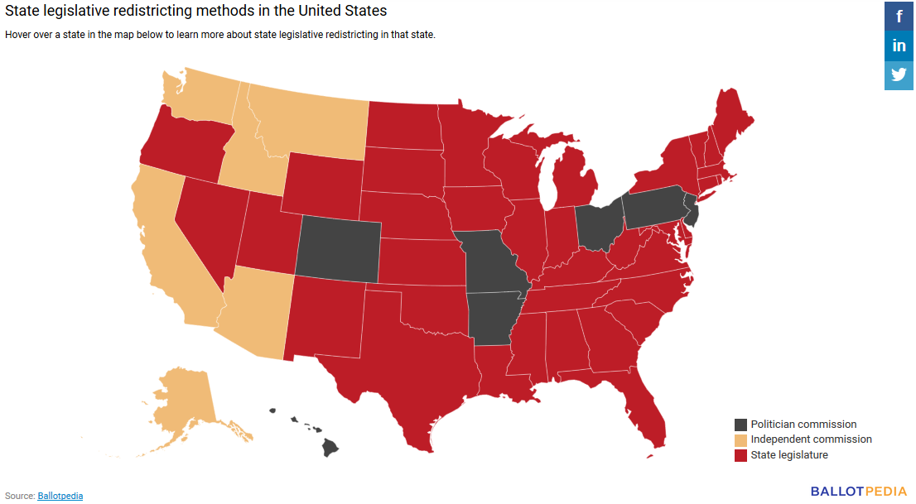
Different strokes for different folks… but its usually politicians making the decisions
https://ballotpedia.org/Redistricting

Slide 14
Want to Restore Competition to Elections in Your State?
Updated for Fall 2022
Center for Voting and Democracy (FairVote.org) lists several ways to reform the fairness of the redistricting process
Add three new requirements to the process:
CONSISTENCY with natural and political boundaries (e.g., county lines)
COMPACTNESS (e.g., low ratio of perimeter to area for each district)
FORBID THE USE OF PARTISANSHIP DATA, like voter registration levels, voting histories, or locations of incumbents’ homes
Change the law to force compromise between the two parties
Require the state courts to approve the map as complying with the established criteria
https://www.fairvote.org/redistricting#research_redistrictingoverview

Slide 15
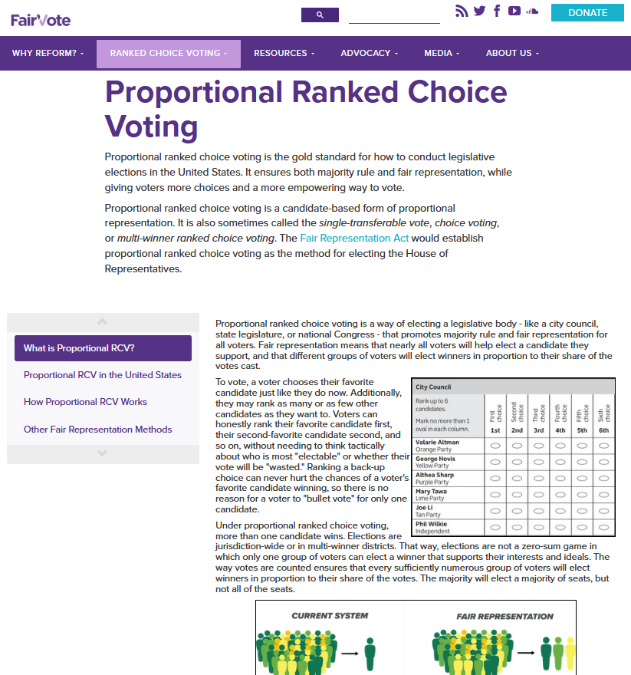
Want to Restore Competition to Elections in Your State?
Updated for Fall 2022
FairVote.org also recommends switching to Proportional Ranked Choice Voting (PRCV) to “end gerrymandering” in all legislative elections
“Proportional” ends winner-take-all politics, resulting in multiple winners in each “super district” and helping legislatures look more like their voters
“Ranked Choice” ends the need for runoff elections—read more here: https://www.fairvote.org/prcv#what_is_prcv
PRCV was the method proposed in the 2021 Fair Representation Act in Congress
https://www.fairvote.org/prcv#what_is_prcv
https://www.fairvote.org/redistricting#research_redistrictingoverview

Slide 16
How Do Legislators Really “Represent” Constituents?
Today’s representational model is based on communication, not congruency
Legislators are “linked” to their citizen constituents by political parties, elections, interest groups—all means of communication between them
Communication both directions can be spotty, biased, and minimal, depending on who you are
Little-to-moderate congruence exists between legislators and citizens
Views and beliefs may overlap, or not
Key attributes often do not match
Parties (via gerrymandering & low-turnout primaries) pick the representative, or at least have much more input than the citizens

Slide 17
State Legislators by Occupation: Like You?
Occupation | 1976 | 1986 | 1993 | 1995 | 2007
Attorney | 22.3% | 16.4% | 16.5% | 15.5% | 15.2%
Full-Time Legislator | 2.7% | 11.5% | 14.9% | 14.0% | 16.4%
Business Owner | 15.8% | 13.8% | 10.0% | 12.3% | 9.2%
Agriculture | 9.7% | 9.9% | 7.9% | 7.7% | 5.3%
Retired | * | 6.7% | 7.2% | 7.6% | 11.7%
Business: Executive/Manager | 5.4% | 5.8% | 6.2% | 5.4% | 8.7%
Educator: K-12 | 8.0% | 5.7% | 6.2% | 5.5% | 3.9%
Business: Non-manager | 4.4% | 4.6% | 5.1% | 3.9% | 2.8%
Consultant/Professional/Nonprofit | 5.7% | 3.0% | 3.5% | 5.2% | 8.4%
Real Estate | 5.2% | 4.2% | 3.2% | 4.3% | 3.5%
Insurance | 5.3% | 3.4% | 3.2% | 3.2% | 1.8%
Communications/Arts | 2.7% | 2.0% | 2.4% | 2.1% | 2.4%
Medical | * | 1.8% | 2.4% | 2.5% | 3.6%
Government Employee: Local | 3.4% | 1.3% | 2.1% | 2.1% | 1.4%
Educator: College | * | 2.0% | 2.0% | 1.9% | 1.7%
Homemaker | * | 1.0% | 1.3% | 1.1% | 0.6%
Engineer/Scientist/Architect | * | 1.0% | 1.2% | 1.4% | 1.6%
Accountant | * | 0.7% | 0.7% | 0.7% | 0.5%
Government Employee: State | * | 0.1% | 0.4% | 0.4% | 1.0%
Clergy | * | 0.4% | 0.4% | 0.4% | 0.6%
Labor Union | 0.6% | 0.3% | 0.3% | 0.3% | 0.2%
Student | * | 0.3% | 0.3% | 0.3% | 0.2%
Information Not Available | * | 0.1% | 0.2% | 0.2% | 0.0%
Insufficient Information | 9.3% | 3.1% | 2.5% | 2.5% | 0.0%
Notes:
DATA FOLLOWS ON EDUCATION, EMPLOYMENT, SEX AND MOBILITY

Slide 18
State Legislators (2009) vs. Public (2007-2009)
Characteristic | Legislators | Public
Women | 24% | 51%
African-Americans | 9% | 13%
Hispanics | 3% | 15%
Attorneys | 15% | 0.4%
Median age | 56 | 37
How did some of these numbers change over time?

Slide 19
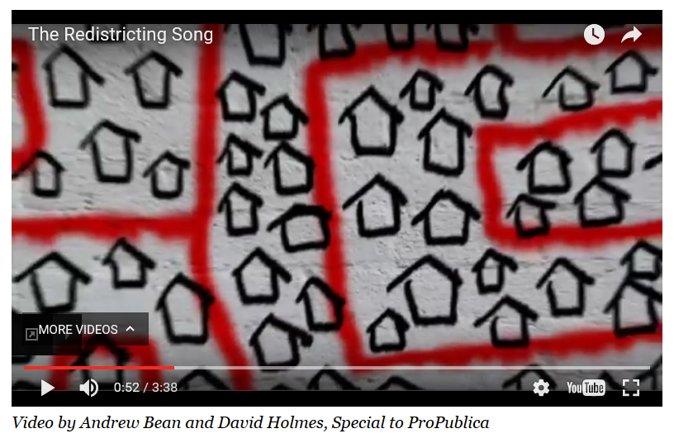
So is representation all it is cracked up to be?
Most assumptions of most people about how representation & elections work are very wrong
Gerrymandering is a formidable tactic, directly contributing to the minimization of elections and the electorates in our democracy
Can it be opposed?
If “yes,” are those solutions specific to time and place, or generalizable?
If “no,” what does this portend?
If you’d like an entertaining review of gerrymandering, check this out: https://youtu.be/bh4qAJDUOcc (…hang with it, it gets better!)
https://www.propublica.org/article/video-the-redistricting-song

Slide 20
Practice Problems …to begin mastering this material. Complete instructions are in the Module 1 resource, How to Use Practice Problems to Prepare for Exams.
Don’t forget to do the…

